Slide 1
Flower Classification: Analysis of Data Augmentation Strategies
Diego Acevedo, Samantha Colbert-Neal, Pallav Kamojjhala
AAI 501: Introduction to Artificial Intelligence

Slide 2
Intro

Slide 3
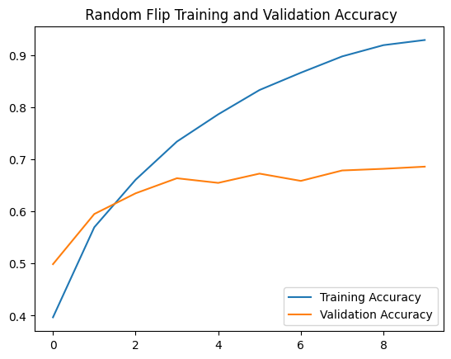
Random Flip

Slide 4
Random Crop

Slide 5
Random Translation

Slide 6
Random Rotation

Slide 7
Random Zoom

Slide 8
Random Contrast

Slide 9
Random Brightness

Slide 10
All Data Augmentation Layers

Slide 11
Validation Accuracy Across Models

Slide 12
Training Accuracy Across Models

Slide 13
Conclusion

